Slide 1

Made yours by:
John Absher, David Gutierrez,
Jason Joachim, and Isaac Lee

Slide 2

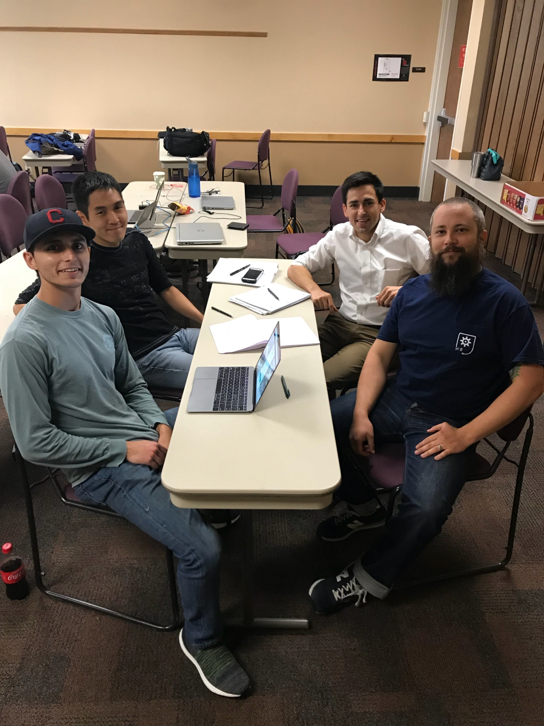


Slide 3






MAI TECHNOLOGIES

Slide 4
